Slide 1
How to process audio data ?
Using the Altera DE2 Board (FPGA)

Slide 2
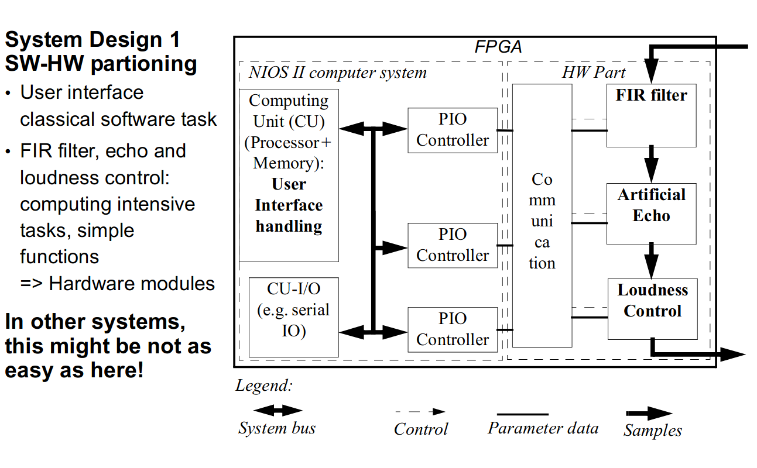
The proposed architecture (DS SoC Lab 1: HW Part)

Slide 3
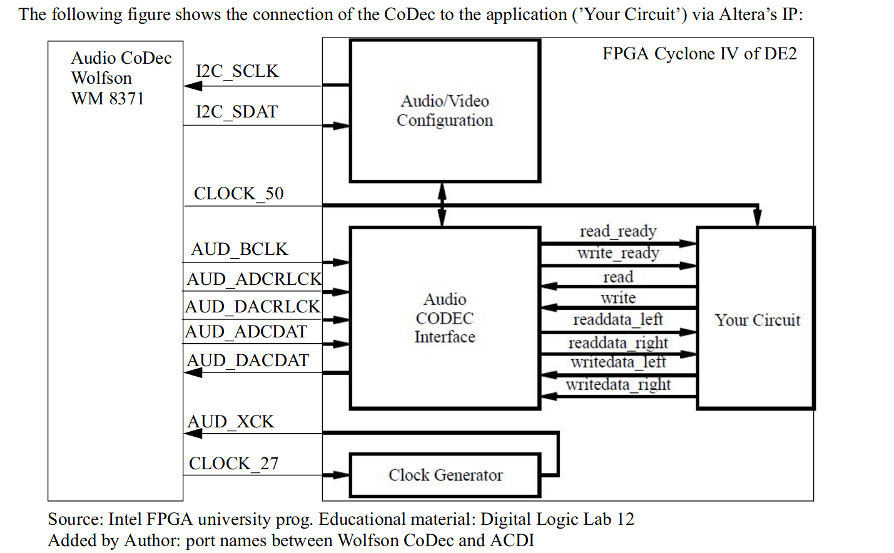
The HW part audio processing (DS Soc Lab 1)

Slide 4
The Idea
Change the FIR Filter with a denoising variational autoencoder ( deep neural network)
Denoising Autoencoder

Slide 5
Expectations
By using a denoising autoencoder it should be possible to detect the trained noise even if there are a lot of background signals and the audio signal is changing a bit because of the underlying patterns the autoencoder can learn.

Slide 6
How to Audio Data gets actually processed

